Slide 1
dynamic programming
CS340

Slide 2
Rod Cutting
How to cut steel rods into pieces in order to maximize the revenue you can get?
Each cut is free. Rod lengths are always an integral number of inches.
Input: A length n and table of prices p_{i} , for i = 1, 2, … , n.
Output: The maximum revenue obtainable for rods whose lengths sum to n, computed as the sum of the prices for the individual rods.

Slide 3
Rod Cutting
Table of prices:
Can cut up a rod in 2^{n-1} different ways, because can choose to cut or not cut after each of the first n - 1 inches.
Length i | 1 | 2 | 3 | 4 | 5 | 6 | 7 | 8
Price p_{i} | 1 | 5 | 8 | 9 | 10 | 17 | 17 | 20

Slide 4
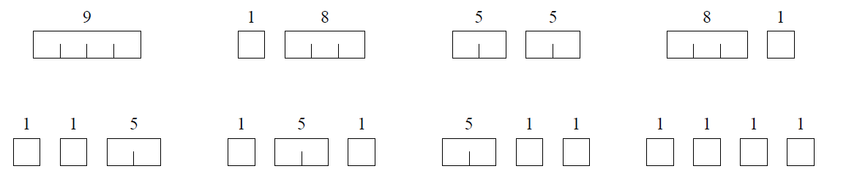
Rod Cutting
Length i | 1 | 2 | 3 | 4 | 5 | 6 | 7 | 8
Price p_{i} | 1 | 5 | 8 | 9 | 10 | 17 | 17 | 20
Table of prices:
Here are all 8 ways to cut a rod of length 4, with the costs from the example:
How many ways are repeats of other ways?
Which way of cutting gives the most revenue?

Slide 5
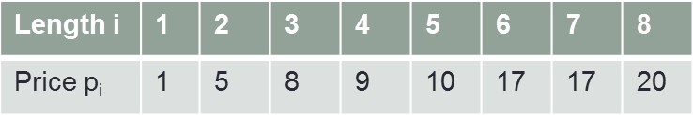
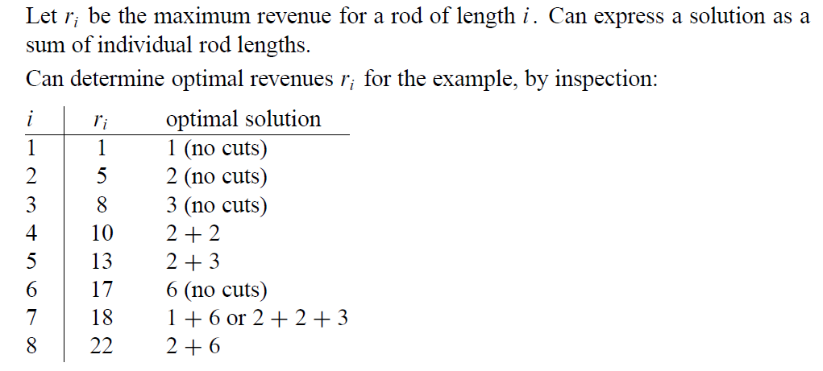
Rod Cutting

Slide 6
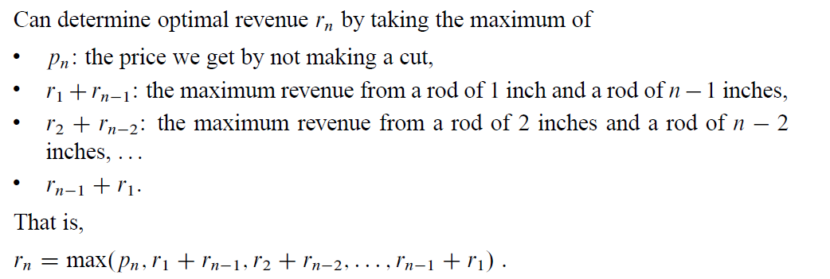
Rod Cutting
To solve the original problem, solve problems on smaller sizes. It is recursive in nature.

Slide 7
Rod Cutting
Dynamic-programming solution
Instead of solving the same subproblems repeatedly, arrange to solve each subproblem just once.
Save the solution to a subproblem in a table, and refer back to the table whenever we revisit the subproblem.
“Store, don’t recompute” → time-memory trade-off.
Can turn an exponential-time solution into a polynomial-time solution.

Slide 8
Rod Cutting
Bottom-up
Sort the subproblems by size and solve the smaller ones first. That way, when solving a subproblem, have already solved the smaller subproblems we need.

Slide 9
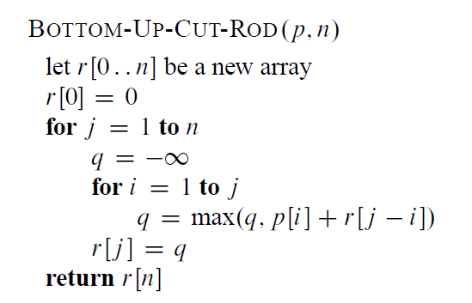
Rod Cutting
Length i | 0 | 1 | 2 | 3 | 4 | 5 | 6 | 7 | 8
Price p_{i} | 0 | 1 | 5 | 8 | 9 | 10 | 17 | 17 | 20
Revenue r_{i} | 0 | 1 | 5 | 8 | 10 | 13 | 17 | 18 | 22
What is the time complexity?
Notes:
Two for loops, time complexity = θ(n²)

Slide 10
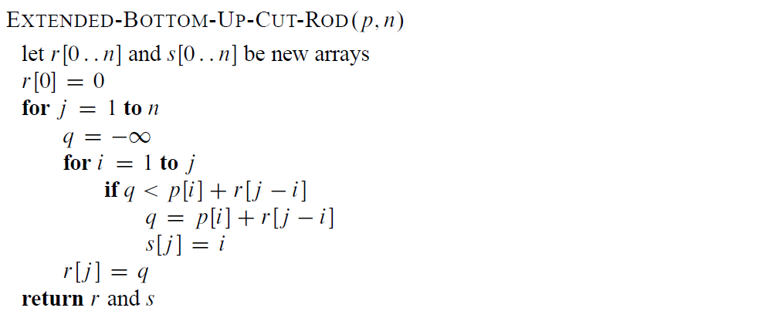
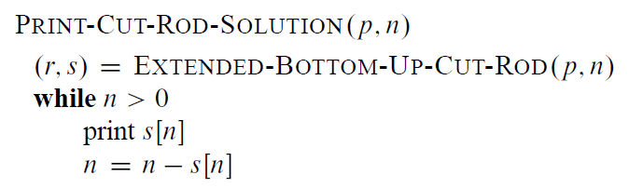
Rod Cutting
Length i | 0 | 1 | 2 | 3 | 4 | 5 | 6 | 7 | 8
Price p_{i} | 0 | 1 | 5 | 8 | 9 | 10 | 17 | 17 | 20
Revenue r_{i} | 0 | 1 | 5 | 8 | 10 | 13 | 17 | 18 | 22
Cuts s_{i} | 0 | 1 | 2 | 3 | 2 | 2 | 6 | 1 | 2
Record optimal choices (locations of cuts) in addition to optimal revenues.
Notes:
A call to PRINT-CUT-ROD-SOLUTION(p, 8) calls EXTENDED-BOTTOM-UPCUT-ROD to compute the above r and s tables. Then it prints 2, sets n to 6,
prints 6, and finishes (because n becomes 0).

Slide 11
Interview Questions
Show, by means of a counterexample, that the following “greedy” strategy does not always determine an optimal way to cut rods.
Define the density of a rod of length i to be p_{i}/i, that is, its value per inch.
The greedy strategy for a rod of length n cuts off a first piece of length i, where 1 ≤ i ≤ n, having maximum density. It then continues by applying the greedy strategy to the remaining piece of length n − i.

Slide 12
Subset Sum
You have n items {1, 2,…, n}
Each item has a weight {w₁, w₂, … , w_{n}}
You want add as many items as possible, without exceeding a maximum weight, W

Slide 13

Real life examples
Production Scheduling
An assembly line is available for W minutes
You want to schedule jobs to maximize utilization of the line
Filling a knapsack with the maximum possible weight
Carry as many books as possible to school
Don't overload it the knapsack or it will break

Slide 14
How to solve this problem
Items = {2, 1, 13, 4, 2, 8, 1}
Total weight = 11
Optimal solution(s)?

Slide 15
How about a greedy solution?
Bag will hold W weight, there are 3 items
Sort by weight, largest to smallest…
W/2 + 1, W/2, W2
Sort by weight, smallest to largest
1, W/2, W/2
What is the greedy solution?
What is the optimal solution?

Slide 16
Optimal Solution
What properties does an optimal solution have?
How many items are in the optimal solution?
What total weight does the optimal solution have?

Slide 17
Optimal Solution
Imagine the optimal solution consists of a subset of the available items, S
Before we add the last item, the optimal set (so far) is S'
What do we know about the optimal set before the last item was added?
W(S') < W(S) <= W

Slide 18
Optimal Solution
Why wasn't item x added?
It would have gone over the weight limit
W(S') + W(x) > W
It wasn't optimal
W(S') + W(x) < W(S') + the last item added (=W(S))

Slide 19
Optimal Solution
At the first step, the first item is added to the knapsack
At each successive step, either
The next item is added to the knapsack
The next item is not added to the knapsack
One of these choices will lead to the optimal solution
It doesn't matter which if we calculate them all
There are N items that can be added. Max weight is W
How many distinct problems are there?

Slide 20
Optimal Solution
There are actually only n x W distinct subproblems to consider!
Hence: Create an n x W matrix
Each entry corresponds to the OPT total value for the first i items subject to a total weight of W

Slide 21
An example
Items w_{i} = {2,3,4}
W = 6
What is the optimal solution?

Slide 22
An example
3 | 0
2 | 0
1 | 0
0 | 0 | 0 | 0 | 0 | 0 | 0 | 0
 | 0 | 1 | 2 | 3 | 4 | 5 | 6
i
i-1
W
w-w_{i}
w
A row represents:
The better of
The optimum so far (from the row below) = OPT(i-1,w)
The optimum so far + the next item = w_{i} + OPT(i-1, w-w_{i} )
Items w_{i} = {2,3,4}
N = 3
W = 6

Slide 23
An example
3 | 0 | 0 | 2 | 3 | 4 | 5 | 6
2 | 0 | 0 | 2 | 3 | 3 | 5 | 5
1 | 0 | 0 | 2 | 2 | 2 | 2 | 2
0 | 0 | 0 | 0 | 0 | 0 | 0 | 0
 | 0 | 1 | 2 | 3 | 4 | 5 | 6
i
i-1
W
w-w_{i}
w
Items w_{i} = {2,3,4}
N = 3
W = 6
Each cell = OPT(i,w)
if w< w_{i} then OPT(i,w) = OPT(i-1,w)
else OPT(i,w) = MAX(OPT(i-1,w), w_{i} + OPT(i-1, w- w_{i} )

Slide 24
Another example
Items = {2,1,2,3}
N = 4
W = 6
4 (3) | 0
3 (2) | 0
2 (1) | 0
1 (2) | 0
0 | 0 | 0 | 0 | 0 | 0 | 0 | 0
 | 0 | 1 | 2 | 3 | 4 | 5 | 6
i
W

Slide 25
What is the complexity
What is the complexity of each computation?
How many computations? (nxW)
Is this polynomial time, based on the size of the input?
What is the size of the input?
What happens if W is large?
W is not the representation of W
W depends on how many bits are used to encode it
Think about a binary representation of W requiring 2^{k} bits
If we double W, the input size increases by 1 bit, but running time doubles
Running time is exponential in k = O(n2^{k})

Slide 26
The Knapsack Problem
A lot like subset sum, but each item has a value in addition to a weight.
Value vector {v₁, v₂, … , v_{n}}
We want to maximize value, while not exceeding maximum weight. Some items might be proportionately more valuable than others.

Slide 27
The Knapsack Problem
Each cell = OPT(i,w)
if w< w_{i} then OPT(i,w) = OPT(i-1,w)
else OPT(i,w) = MAX(OPT(i-1,w), v_{i} + OPT(i-1, w- w_{i} )
What's different?

Slide 28
The Knapsack Problem
Weights = {2,1, 2, 3}
Values = {4, 5, 1, 2}
N = 4
W = 6
4 | 0
3 | 0
2 | 0
1 | 0
0 | 0 | 0 | 0 | 0 | 0 | 0 | 0
 | 0 | 1 | 2 | 3 | 4 | 5 | 6
i
W

Slide 29
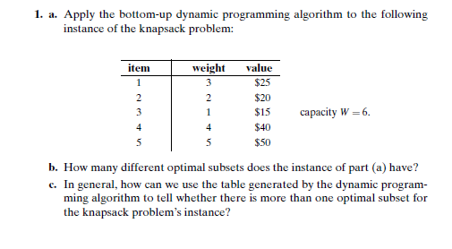
Interview Questions

Slide 30
Sequence Alignment
Problem: Given two strings S and T, what is the optimal “alignment” between them?
Minimum number of changes made to transform S into T, respecting order of characters
Motivation and Applications:
Spell checker
Genetic similarity computation: DNA seq. align.
“changes” from S to T model mutation events
Simplest form: Longest Common Subsequence
Match, Insertion, or Deletion (no substitutions)

Slide 31
Sequence Alignment
O_CURRANCE
OCCURRENCE
How do the 2 words align?
A gap must be added to ocurrance
An A must be replaced by an E

Slide 32
Sequence Alignment
How about this?
O_CURR_ANCE
OCCURRE_NCE
Which is better?
One gap and one mismatch
Three gaps and no mismatches

Slide 33
How do we get there?
Need to compute the measure we are trying to optimize
Two general and equivalent formulations:
MINIMIZE the “changes” (insertions and deletions)
Later the changes will also involve substitutions
MAXIMIZE the “matches”
Many problems presented in “optimization” frameworks
To speak more generally:
MINIMIZE PENALTIES (COSTS)
MAXIMIZE REWARDS (SCORES)

Slide 34
General Sequence Alignment
Some mismatches are far likelier than others!
In English: (c,k), (a,e), (e,i), (i,y), (q,k),(u,a),(s,c)
Unlikely substitutions: (a,t), (k,r),(p,x)
The commonality between SELECT and SALEKT is not restricted to SLET
That would make them as similar with each other as they are with “SLEET”!
For DNA and protein sequences the relative likelihoods are of critical importance!

Slide 35
Gap and Substitution Scores
δ is a gap score based on penalization
Each gap we insert incurs δ score
δ < 0
α is a substitution score, including possible matches
For each pair of letters p,q, there is a substitution score α_{p,q} for lining up letters that do not match (when p not equal q).
In general, α_{p,p} > 0, and α_{p,p} > α_{p,q}
Perfect match substitutions are rewarded more than any other event.
δ and α are external parameters that must be determined.

Slide 36
Substitution Matrices
Need to encode likelihood information to the alignment program as INPUT
|A| x |A| substitution matrix S
Where |A| is alphabet size
|A| = 26 in English but
|A| = 4 only for DNA sequences
Sometimes can treat S as a “function” instead
int S(x,y) { if (x == y) return +2,
else if (x and y are similar) return +1,
else return -1 }

Slide 37
Which Alignment is Preferred?
O_CURRANCE
OCCURRENCE
VS
O_CURR_ANCE
OCCURRE_NCE
Which is better?
The first is better if δ + α_{ae} > 3δ

Slide 38
Optimal Alignment Observation
In an optimal alignment M of 2 strings X and Y, at least one of the following is true:
(m, n) ∊ M
In this case the last event is a SUBSTITUTION or perfect match
the mth position of X is not matched
In this case the last event is an INSERTION or gap across the last letter of Y
the nth position of Y is not matched
In this case the last even is a DELETION or gap across the last letter or X
opt(i, j) = max[
α_{xi yj} + opt(i - 1, j - 1)
δ + opt(i - 1, j)
δ + opt(i, j - 1)
]

Slide 39
A Sample Model (as in Project 6)
(a) match score: a
(b) gap score: b
(c) two types of mismatch (substitution) scores:
(i) a substitution score c for the following similar non-identical pairs of letters:
{b,p}, {c,k}, {c,s}, {d,t}, {e,y}, {g,j}, {g,k}, {i,y}, {k,q}, {m,n}, {s,z}, {v,w}
All vowel-vowel pairs.
(ii) a substitution score d for dissimilar pairs of letters (all other non-identical pairs).
a > c > 0, d < 0, and b < 0

Slide 40
A Default Setting
Perfect match score a = +2
Gap score b = -2
Substitution scores:
Similar letter substitution score c = +1
Dissimilar letter substitution score d = -1

Slide 41
Examples
SELECT and SALLEKT (on board)
SELECT and SALEKT
SCALE SKEL
SO and (on board)
AS, SOOOO, SUE

Slide 42
Rerun
T | -12 | -8 | -5 | -1 | 3 | 6 | 10
C | -10 | -6 | -3 | 1 | 5 | 8 | 6
E | -8 | -4 | -1 | 3 | 7 | 5 | 3
L | -6 | -2 | 1 | 5 | 3 | 1 | -1
E | -4 | 0 | 3 | 1 | 0 | -2 | -4
S | -2 | 2 | 0 | -2 | -4 | -6 | -8
- | 0 | -2 | -4 | -6 | -8 | -10 | -12
 | - | S | A | L | E | K | T

Slide 43
Another example
E | -10
L | -8
A | -6
C | -4
S | -2
- | 0 | -2 | -4 | -6 | -8
 | - | S | K | E | L

Slide 44
Another example
E | -10 | -6 | -3 | 1 | 4
L | -8 | -4 | -1 | 2 | 6
A | -6 | -2 | 1 | 4 | 2
C | -4 | 0 | 3 | 1 | -1
S | -2 | 2 | 0 | -2 | -4
- | 0 | -2 | -4 | -6 | -8
 | - | S | K | E | L

Slide 45
Longest Common Subsequence
In the LCS problem, it does not make sense to allow mismatch substitutions
Only perfect match or gap events possible
How can one model this situation?
Return to considering LCS for previous examples.

